Slide 1



ASTROSAGE ANALYSIS
PREPARED BY:
MALLEKHA TABASSUM

Slide 2
INTRODUCTION & OBJECTIVE
Introduction:
Since 2004,
AstroSage has been driven by a single mission: to make astrology accessible, credible, and useful for everyone.
AstroSage have always been at the forefront of merging deep astrological knowledge with cutting- edge tech, building not just for industry, but for the nation.
Objectives:
Analyze call volume and customer satisfaction data.
Identify performance gaps and workload imbalance.
Recommend data-driven strategies to improve overall efficiency.

Slide 3
DATA OVERVIEW
Scope of Analysis:
User behavior: repeat vs. new callers
Guru performance and workload distribution
Call outcomes: completed, failed, busy, no-answer
Revenue generation by service type (Calls, Chats, Live Sessions)
Customer satisfaction based on CSAT ratings

Slide 4
METHODOLOGY
Analytical Approach:
Cleaned and standardized data.
Performed trend and correlation analysis using PivotTables.
Visualized insights with bar, pie, and heatmap charts.
Identified KPIs: call volume, utilization, satisfaction, and cost.
Derived strategic insights linking gaps to investments.
Tools Used:
Microsoft Excel (PivotTables, charts, conditional formatting)
Functions: COUNT, AVERAGE, CORREL, STDEV
Interactive dashboards with slicers and filters

Slide 5
USER’S RATING DISTRIBUTION
RATING WISE DISTRIBUTION
8000
Most users rated 0, followed by 4407
users giving a rating of 3. Around 2000
7256
7000
users rated between 1 and 8, showing mixed satisfaction.
6000
5000
4329
4407
4000
Total
3000
2199
2132
2169
1882
2000
1829 1824
1000
0
0
1
2
3
4
5
6
7
8

Slide 6

CALL STATUS DISTRIBUTION
CALL STATUS DISTRIBUTION
41% of calls were completed, but 59% faced issues like no answer, busy, incomplete or failed — showing room for improvement in call handling.
busy 15%
no-answer
20%
incomplete 10%
busy completed
failed incomplete no-answer (blank)
failed 14%
completed 40%

Slide 7
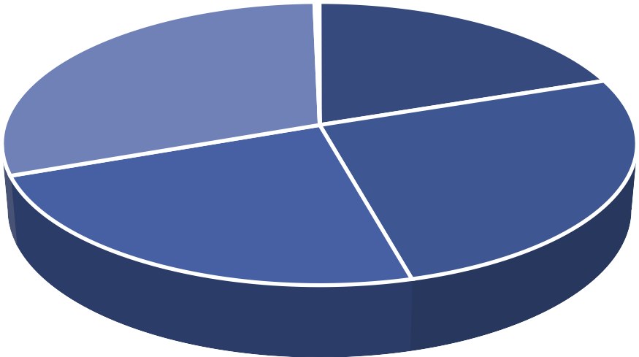
CHAT STATUS DISTRIBUTION
CHAT STATUS DISTRIBUTION
Only 20% of chats were completed, while over 50% failed or remained incomplete, highlighting serious technical and quality
pending 0%
issues in chat handling.
On Call 30%
started 0%
completed 20%
incomplete 24%
failed 26%
completed
failed
incomplete
On Call
pending
started

Slide 8
HOUR WISE CALL DISTRIBUTION
CALL DISTRIBUTION BY HOURS
Calls peak at 8 AM and stay high from 6–11 AM and 2–4 PM, while late-night hours are quiet.
700
660
600
605
₅₄₁551
Insight: Focus staffing during peaks and automate after 8 PM for efficiency.
515
513₄₉₇
498
500
483
479
437
449
400
374
348
Total
300
265
264
223
200
172
129
99
73 70
100
68
52
0
0 1 10 11 12 13 14 15 16 17 18 19 2 20 21 22 23 3 4 5 6 7 8 9

Slide 9
TOP 10 GURU’S WITH HIGHEST RATING
TOP 10 GURU'S WITH HIGHEST RANKING
Tarot Mystical and Astro Poojaa Rai lead with 7+ ratings, and all top 10 maintain high consistency.
Astro Manish S
5.0
Tarot Oormika
5.4
Astro Trisha
5.4
Insight: Highlight and reward top gurus to boost credibility and service quality.
Tarot Diva Poonam
5.5
Astro Saraswat
5.6
Total
Tarot Ankita
5.8
Astro Reema
5.9
Daljit Kaur
5.9
Astro Pujaa Rai
7.5
Tarot Mystical
7.5
0.0 1.0 2.0 3.0 4.0 5.0 6.0 7.0 8.0

Slide 10

WEBSITE DISTRIBUTION
WEBSITE DISTRIBUTION
Gurucool leads with 72.2% (20,225 interactions), followed by the app at 27.8% (7,800), while the dashboard is barely used (2 calls).
app 28%
dashboard 0%
Insight: Gurucool dominates usage but
needs urgent UX and performance improvements due to low satisfaction.
gurucool 72%
app dashboard gurucool

Slide 11
REVENUE BY CONSULTATION TYPE
REVENUE BY CONSULTATION TYPE
Calls generate the bulk of revenue (78.7% /
₹1,68,442), while chats, despite forming 70% of interactions, contribute only 21.3% /
₹45,495. Complementary sessions and Public Live Calls add almost nothing.
180000
168442.035
160000
140000
Insight: Focus on improving call quality for
120000
revenue growth and optimize chats for efficient support.
Total
100000
80000
60000
45494.68333
40000
20000
0
50.597
0
Call
Chat
Complementarypublic_live_Call

Slide 12
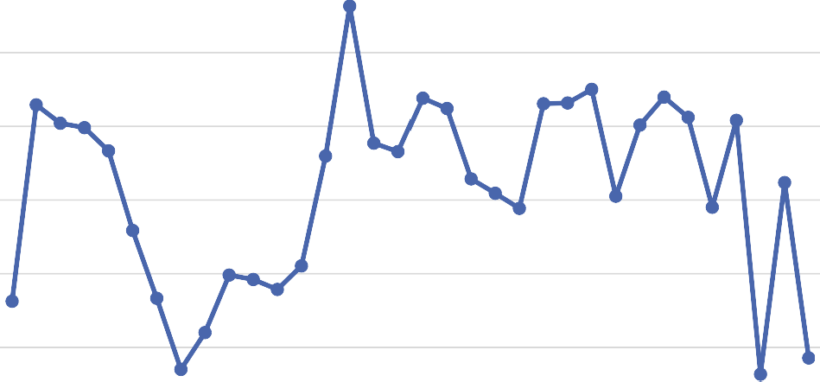
DAILY CALL VOLUMES
DAILY CALL VOLUMES
1400
1324
A total of 28,087 calls were handled, averaging 825 calls per day. The peak day was December 15 with 1,324 calls,
1200
1074
1098
1077
1056
100₉6₉₄
931
1046
10519061
1001
1022 1014
1000
917
952₉₂₉
while the lowest was January 1 with just
325 calls.
855
816
808
845
800
715
775
778
594₅₈₂
555
619
600
523
531
Total
438
338
400
325
369
200
0
2023-12-06
2023-12-01
2023-12-02
2023-12-03
2023-12-04
2023-12-05
2023-12-07
2023-12-08
2023-12-09
2023-12-10
2023-12-11
2023-12-12
2023-12-13
2023-12-14
2023-12-15
2023-12-16
2023-12-17
2023-12-18
2023-12-19
2023-12-20
2023-12-21
2023-12-22
2023-12-23
2023-12-24
2023-12-25
2023-12-26
2023-12-27
2023-12-28
2023-12-29
2023-12-30
2023-12-31
2024-01-01
2024-01-02
2024-01-03

Slide 13
STRATEGIC RECOMMENDATIONS
Tech Upgrade (Priority): Implement CRM, AI-based routing, and speech analytics to enhance efficiency.
Training Programs: Launch the Guru Excellence Program to improve low performers using best practices from top gurus.
Customer Retention: Reduce 57.35% repeat calls through first-call resolution (FCR), proactive callbacks, and chatbot support.
Performance Monitoring: Use live dashboards and incentive-linked KPIs for continuous improvement.
Impact: Achieve balanced workload, higher CSAT, fewer repeat calls, and sustainable profitability.

Slide 14
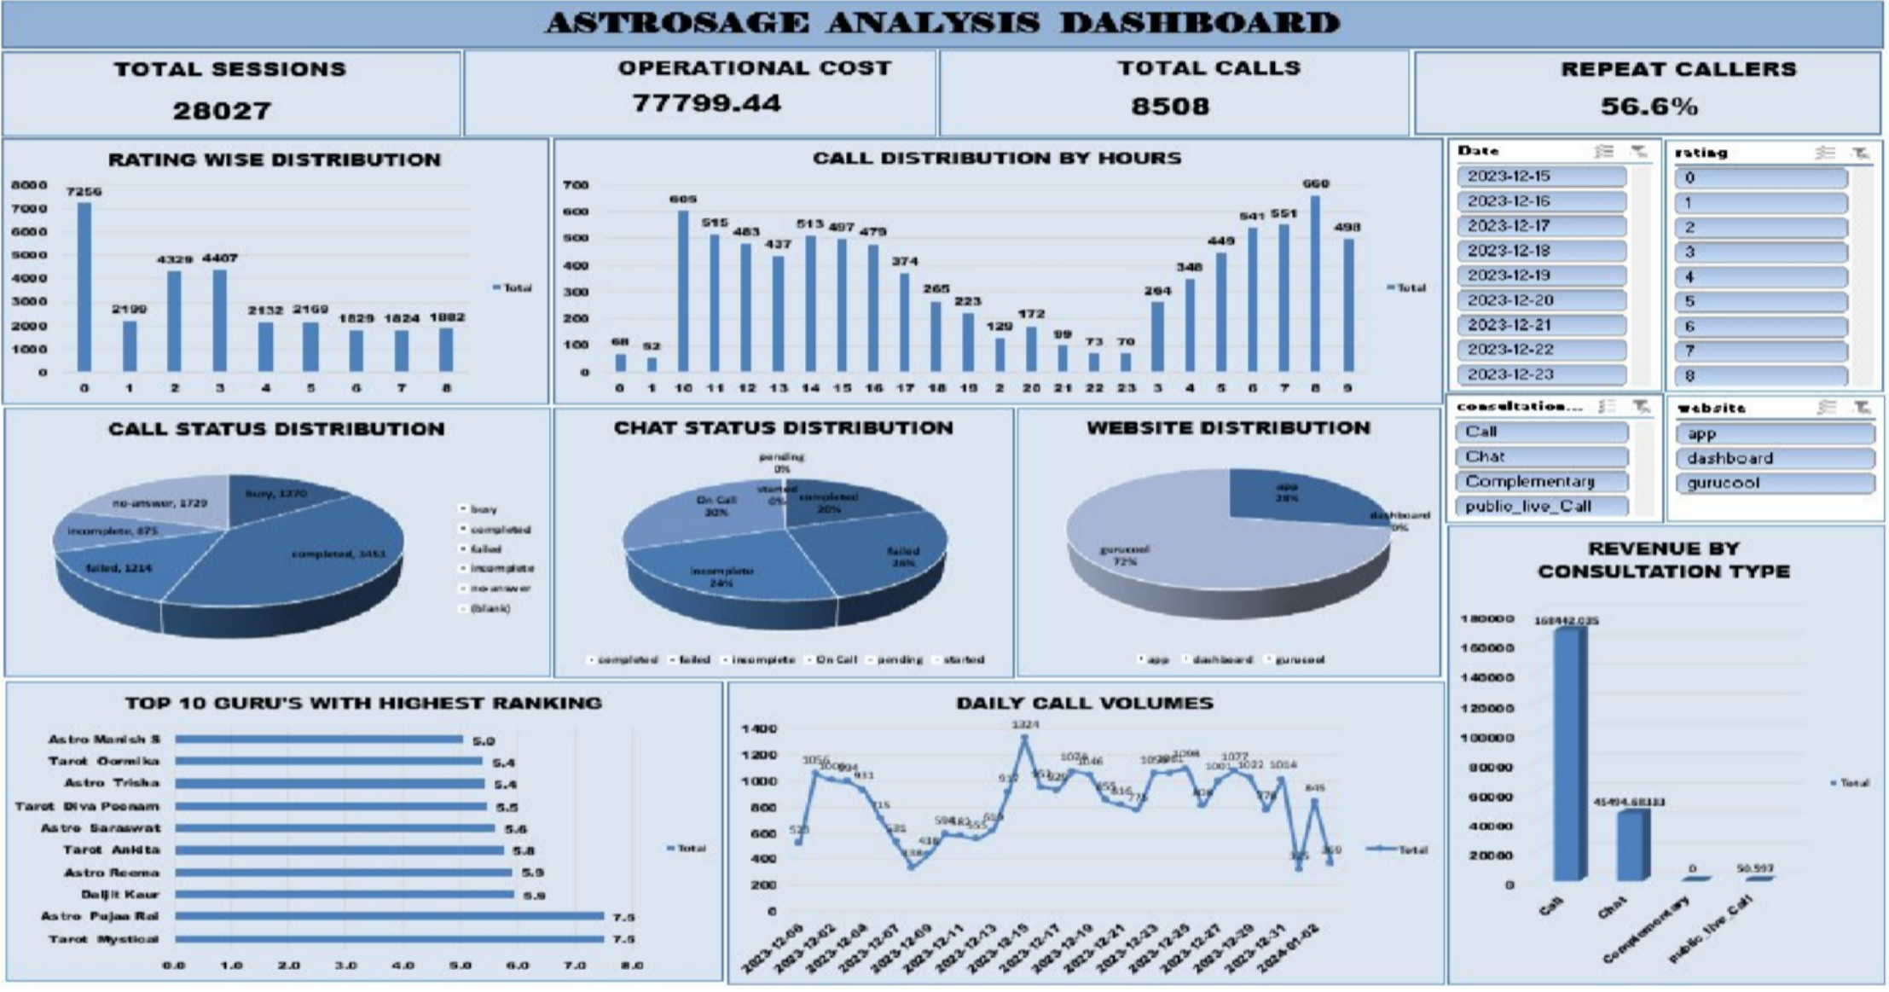

Slide 15
CONCLUSION
Analysis of 28,027 consultations revealed key gaps — only 40% completion and 57% repeat calls. Low satisfaction (ratings 0–3) shows inconsistent service, though top gurus (avg. 7.5) prove excellence is achievable. Investing in Technology, Training, and Incentives can enhance efficiency, retention, and profitability.
“With data-driven action, AstroSage can turn inefficiencies into strengths — building a smarter, customer-centric, and future-ready call center.”

Slide 16
THANK YOU

